Slide 1
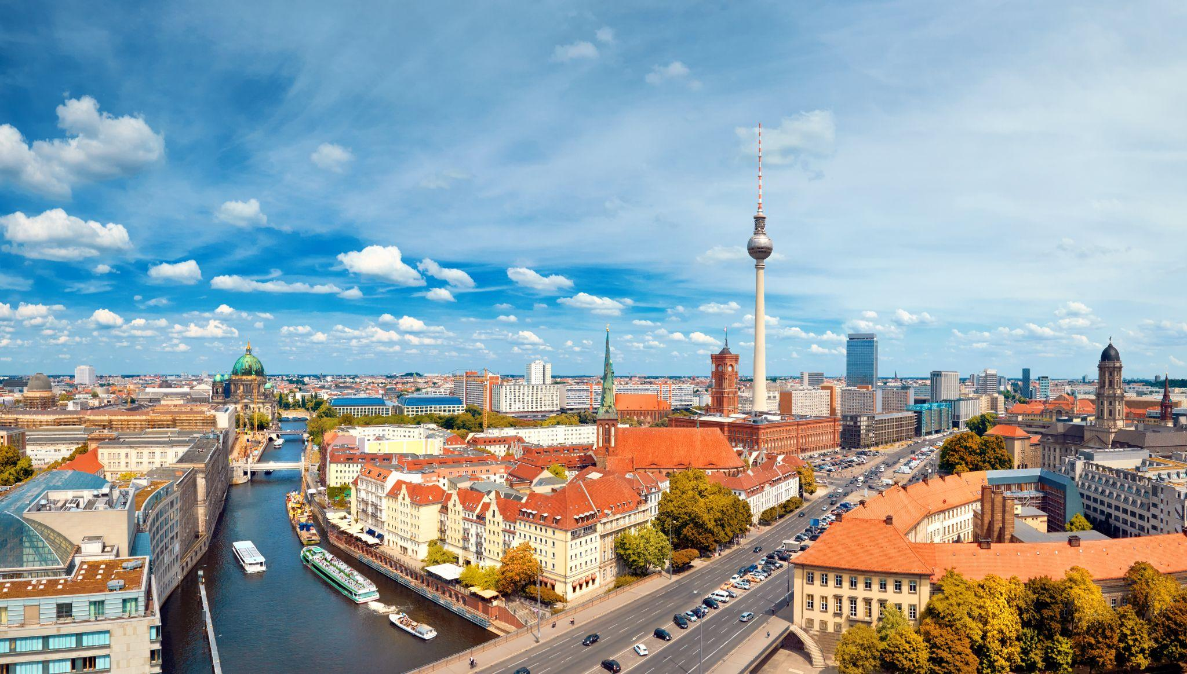
Berlin VS Madrid: Knowing the services by area
Author: Jose Javier Nicolas

Slide 2
Introduction
We want to compare the offer in lisure and services between 2 big cities like Madrid and Berlin¡. Two of them are capital cities inside the European Union.
Berlin is the capital and largest city of Germany by both area and population. Its 3.8 million inhabitants make it the European Union's most populous city, according to population within city limits. One of Germany's sixteen constituent states, Berlin is surrounded by the State of Brandenburg and contiguous with Potsdam, Brandenburg's capital. Berlin's urban area, which has a population of around 4.5 million, is the second most populous urban area in Germany after the Ruhr. The Berlin-Brandenburg capital region has over six million inhabitants and is Germany's third-largest metropolitan region after the Rhine-Ruhr and Rhine-Main regions.
Madrid is the capital and most-populous city of Spain. The city has almost 3.4 million inhabitants and a metropolitan area population of approximately 6.7 million. It is the second-largest city in the European Union (EU), surpassed only by Berlin in its administrative limits, and its monocentric metropolitan area is the second-largest in the EU, surpassed only by Paris. The municipality covers 604.3 km2 (233.3 sq mi) geographical area.
Every year more than 6 million pepople visit Berlin looking for its touristic attraction. Madrid is one of the capital for the tourism. Every year receives more than 7 million visitors to the capital. But which one is offering the best number of services?

Slide 3
Data
For this project data available on the Foursquare's API will be used. It will be used to check data in Berlin and Madridin terms of their neighborhoods. The data used includes information about different venues and their neighborhoods.
Info an access for Foursqure Api https://developer.foursquare.com/
Also we will extract the Berlin districts from Wikipedia: https://en.wikipedia.org/wiki/Boroughs_and_neighborhoods_of_Berlin
Also we will extract the Berlin districts from Wikipedia: https://en.wikipedia.org/wiki/Districts_of_Madrid

Slide 4
Methodology
We will use the KMeans ML technique to segment districts with similar objects based on neighborhood data, and then we can judge the similarity or dissimilarity between districts and two cities
More info: https://en.wikipedia.org/wiki/K-means_clustering

Slide 5
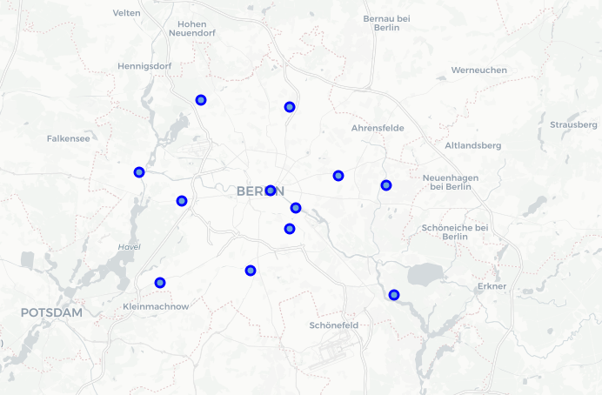
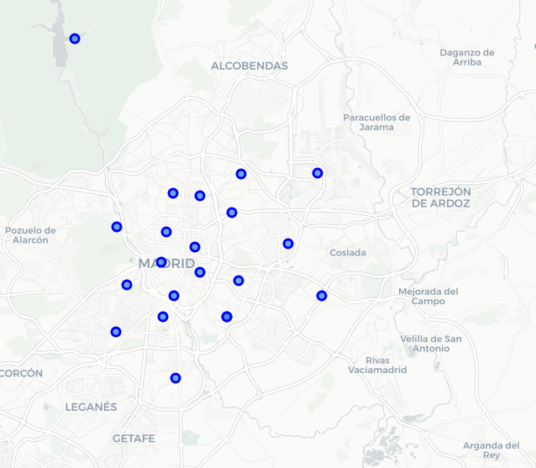
Results
The geographical coordinates of Berlin are 52.5170365, 13.3888599.
The geographical coordinates of Madrid 40.4167047, -3.7035825.
Points and Location for Districts
Berlin
Madrid

Slide 6
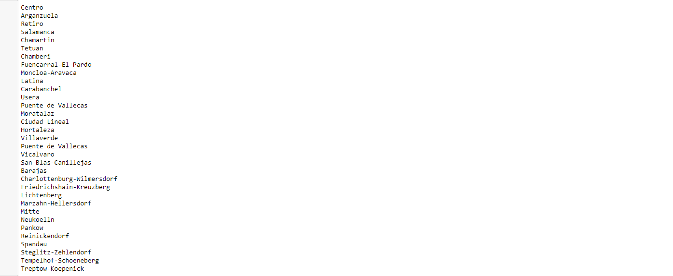
Results
Number of venues in Berlin is 336.
Number of venues in Madrid is 585.
There are 193 unique categories.

Slide 7
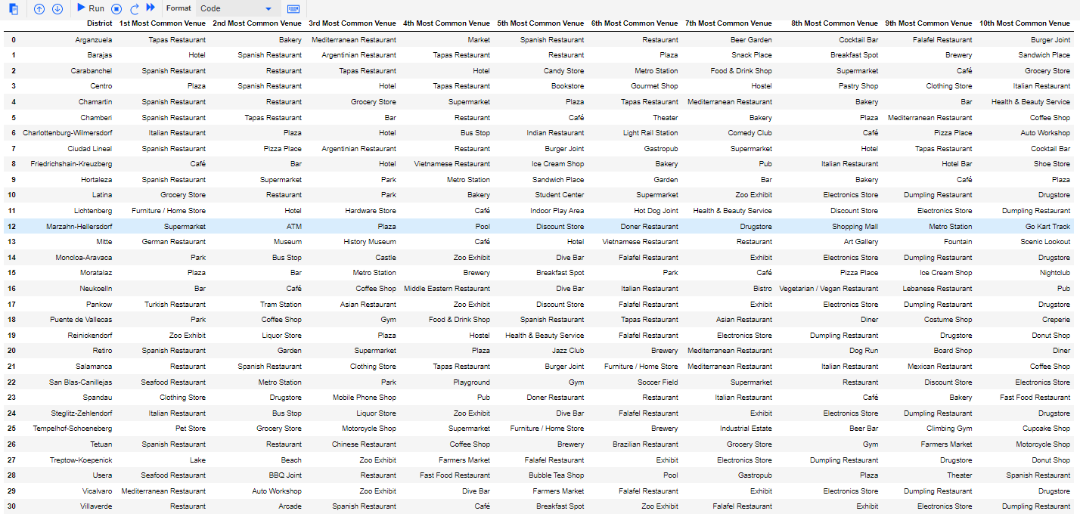
Ten most common venues in all districts:

Slide 8
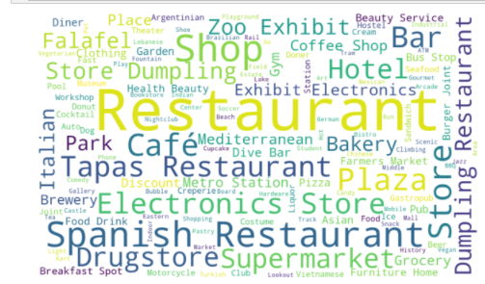
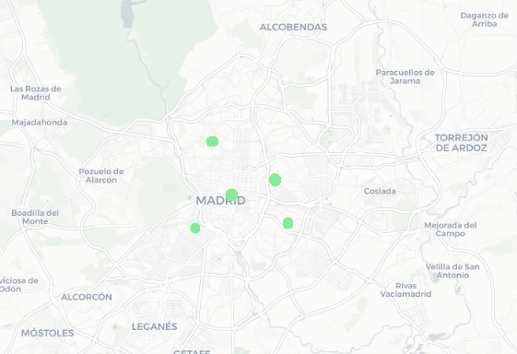
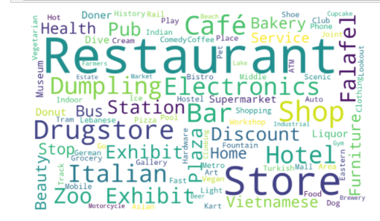
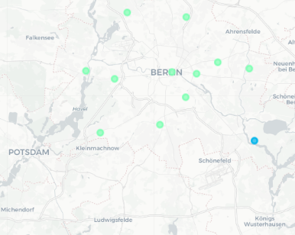
Results
Madrid
Berlin

Slide 9
Discussion
Berlin is a very large city and the capital of Germany. It is home to the vast majority of the country's population. It is also notable for the concentration of companies located in the city. It is normal for a city of this size to offer many services to the population. Many of them are not directly related to tourism but can be an attraction.
For example, the offer in restaurants and coffee shops is very high, responding to the demand of the local population and not only to tourism.
Otherwise Madrid is more fragmentes and splited in more areas than Berlin. Madrid has less habitants than Berlin but receives more number of visitors.

Slide 10
Conclussions
Restaurants and shopping (Flea Markets) are the commun attractives in the City. Followed by Exhibitions and Museums. We could say the the offer of services for tourists is quite extensive. One of the most interesting topics in Berlin are related with gastronomy. Tha activities related with shopping are more frecuently in Berlin than Madrid. It has a significant weight of exhibitions and cultural activities as museum and Zoos.
The main activity in Madrid are reastaurants and tapas Bar. The main of the services in all the areas are related with the gastronomy. It mean there is a high quantaty of this kind of services than in Berlin.

